Slide 1

Project Title: Sysmtpms-Based Disease Predictor and Report Analyzer
University Roll No: 301411023018
Under The Guidance of:
Techonet Pvt Ltd
Presented by:
Anuj Agrawal

Slide 2

Introduction:
The System-Based Disease Prediction System is a Machine-Learning web -Based application platform to predict diseases based on Symptoms entered by users. The System analyzes symptoms data and predicts the most probable disease using a trained Random Forest classification model. In addition to prediction, the system provides disease description, medication information, precautions, and workout recommendation to help users understand and manage their health conditions.

Slide 3
Literature Review:
The emergence of machine learning introduced data-driven approaches capable of learning complex relationships between symptoms and diseases. Modern systems can analyze large healthcare datasets and provide predictions with higher accuracy.
A robust multi-process approach that integrates the decision tree algorithm with clustering techniques was implemented in this system. This methodology aids in the development of a predictive system for cardiac arrest. It can be concluded that the Random Forest classifier algorithm demonstrates superior accuracy and efficiency compared to the other.
Studies show that symptom-based prediction systems can support early diagnosis and timely treatment.

Slide 4
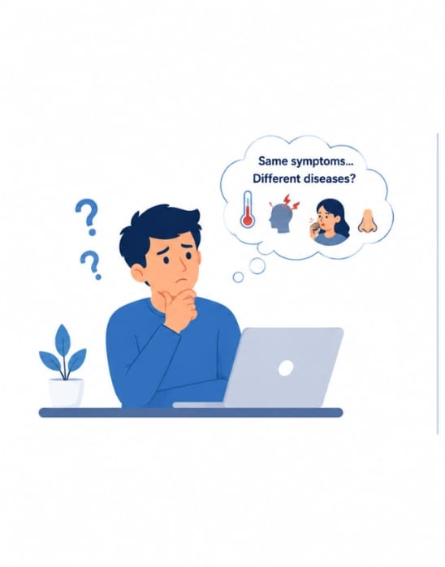

Problem Statement:
Different diseases often share similar symptoms, making it challenging for individuals to identify the correct disease without a systematic prediction approach.
Many people ignore or misinterpret early symptoms, resulting in delayed diagnosis and treatment.
Many people do not have immediate access to healthcare professionals, especially in rural or remote areas, making timely disease identification difficult.

Slide 5
Objectives:
To generate intelligent Disease Prdiction System.
To generate detailed and easy-to-understand disease reports for users.
To compare the performance of different machine learning algorithms and identify the model that provides the highest prediction accuracy.
To assist in early disease detection by providing quick and accurate preliminary predictions, supporting timely medical consultation.

Slide 6
Proposed Methodology:
ABNNB
dd a bit of boKHHJdy text
Random Forest: Random Forest is a machine learning algorithm that combines multiple decision trees to improve prediction accuracy and reduce overfitting.
NumPy: A Python library used for fast numerical computations and efficient array operations, helping process large datasets.
Pandas: A Python library used to load, clean, organize, and analyze the symptom dataset before training the machine learning model.
HTML: A markup language used to create the structure and user interface of the web application, allowing users to enter symptoms and view predictions.
Pickle: A Python module used to save and load the trained machine learning model, eliminating the need to retrain it every time the application runs.
Flask: A lightweight Python web framework that connects the machine learning model with the HTML interface and handles user requests to generate predictions.
Random Forest
Numpy
Pandas
HTML
PICKLE
FLASK

Slide 7
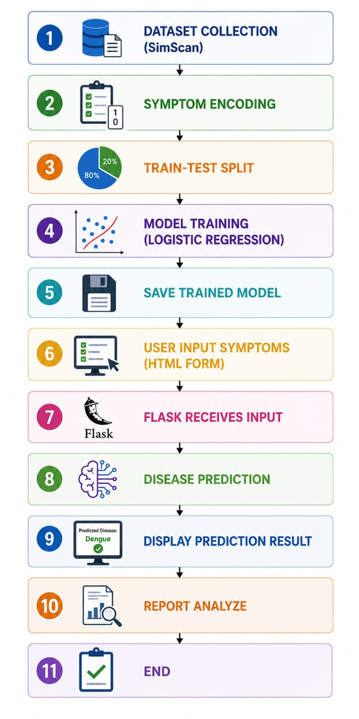
WorkFlow Diagram:

Slide 8
Expected Outcomes:
Asssuming to predict accurate symptoms-Based Disease.
Users gain better awareness of potential health conditions based on their symptoms, promoting proactive healthcare.
The system can generate predictions within seconds, reducing the time required for preliminary disease assessment.

Slide 9
Future Scope:
The system can be connected with hospital databases and electronic health records to improve prediction accuracy and support clinical decision-making.
A mobile app can be developed to allow users to enter symptoms and receive disease predictions anytime and anywhere.
Integrate interactive graphs, charts, and detailed health reports to improve the visualization and interpretation of prediction results.

Slide 10
Conclusion:
The Symptom-Based Disease Prediction System demonstrates how machine learning can assist in predicting diseases from user-provided symptoms. The proposed system provides quick and reliable preliminary predictions, supporting early disease identification and informed healthcare decisions. By integrating data preprocessing, machine learning, and a web interface, the project offers an efficient and user-friendly solution.

Slide 11
Thank You
Presented by Anuj Agrawal

